Slide 1
Restaurant Rating and Search Management system
Presented by
Aarathi Srinivas Nadathur
Chaithanya Reddy Bogadi
Nandini Puppala

Slide 2
Contents
Overview
Key Features
Business Requirements
Technical and Infrastructure Requirements
Backend
Front end

Slide 3
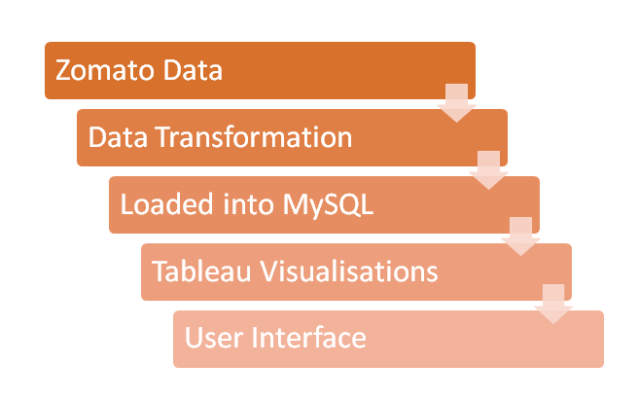
Overview

Slide 4
Key Features
Rating
address
Timings
Food items
price
Delivery

Slide 5
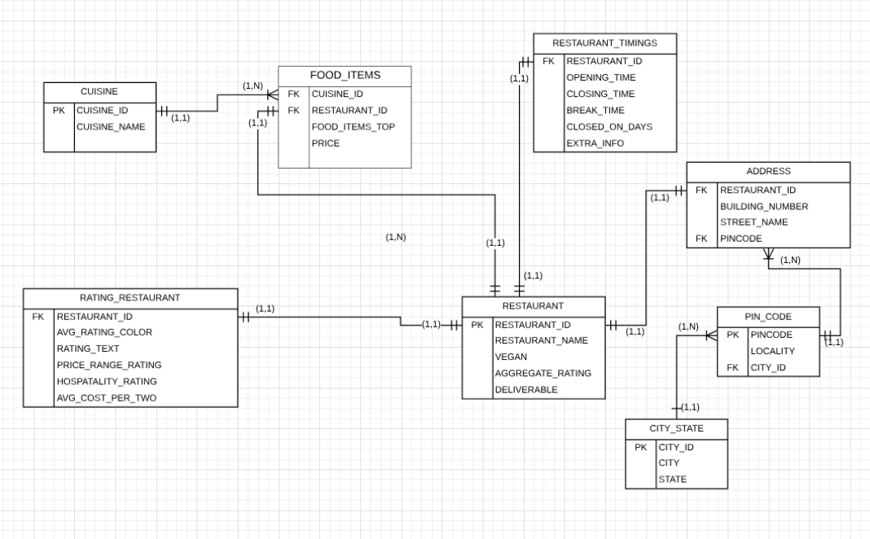
Business Benefits and Goals

Slide 6
Functional Requirements
User plugs in the locality
User plugs in cuisine and pincode
User wants to get a list of vegan restaurants in his city
User wants to find the best rated restaurant
User wants to find a budget friendly restaurant

Slide 7
Technical and Infrastructure Requirements
Hardware Specifications
i7 core processors
16GB RAM
1 GB Hard Disk Space

Slide 8
Software Specifications
My SQL workbench 8.0 CE
Python
Mircosoft Excel 2013
Tableau Public
Xampp Server

Slide 9
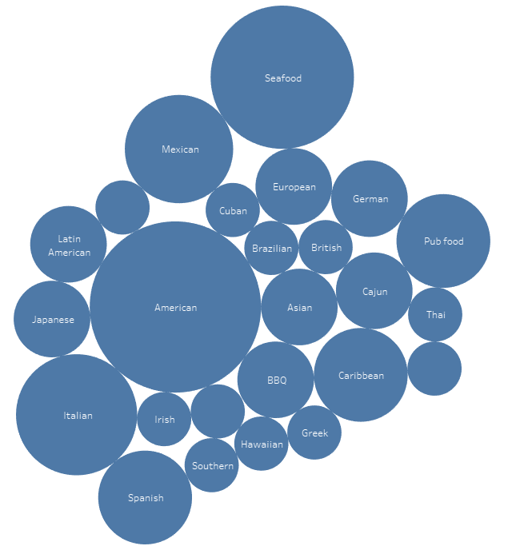
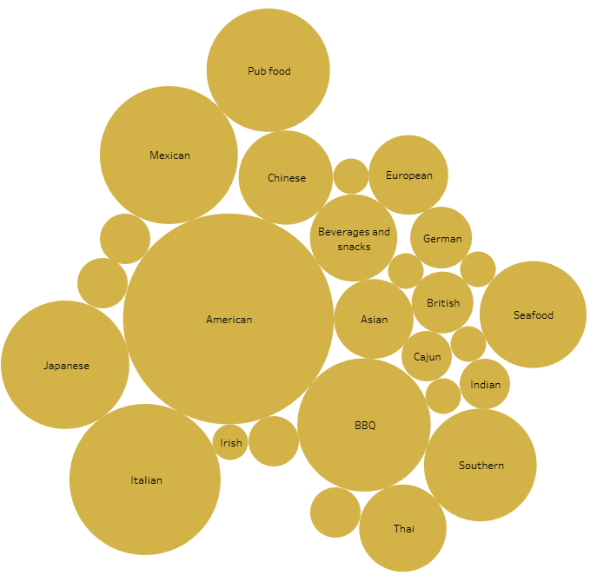
Queries What are the Top Preferred cuisines by customers at Georgia and Florida
GEORGIA
FLORIDA

Slide 10
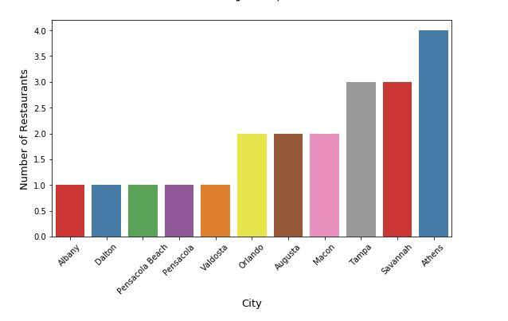
The restaurants in different cities that deliver American food with an aggregate rating greater than 3

Slide 11
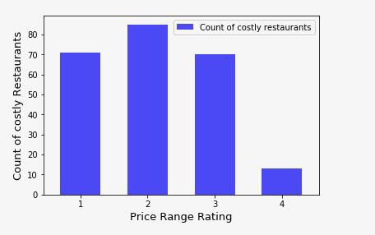
Count of restaurants based on pricing category

Slide 12


User Interface

Slide 13

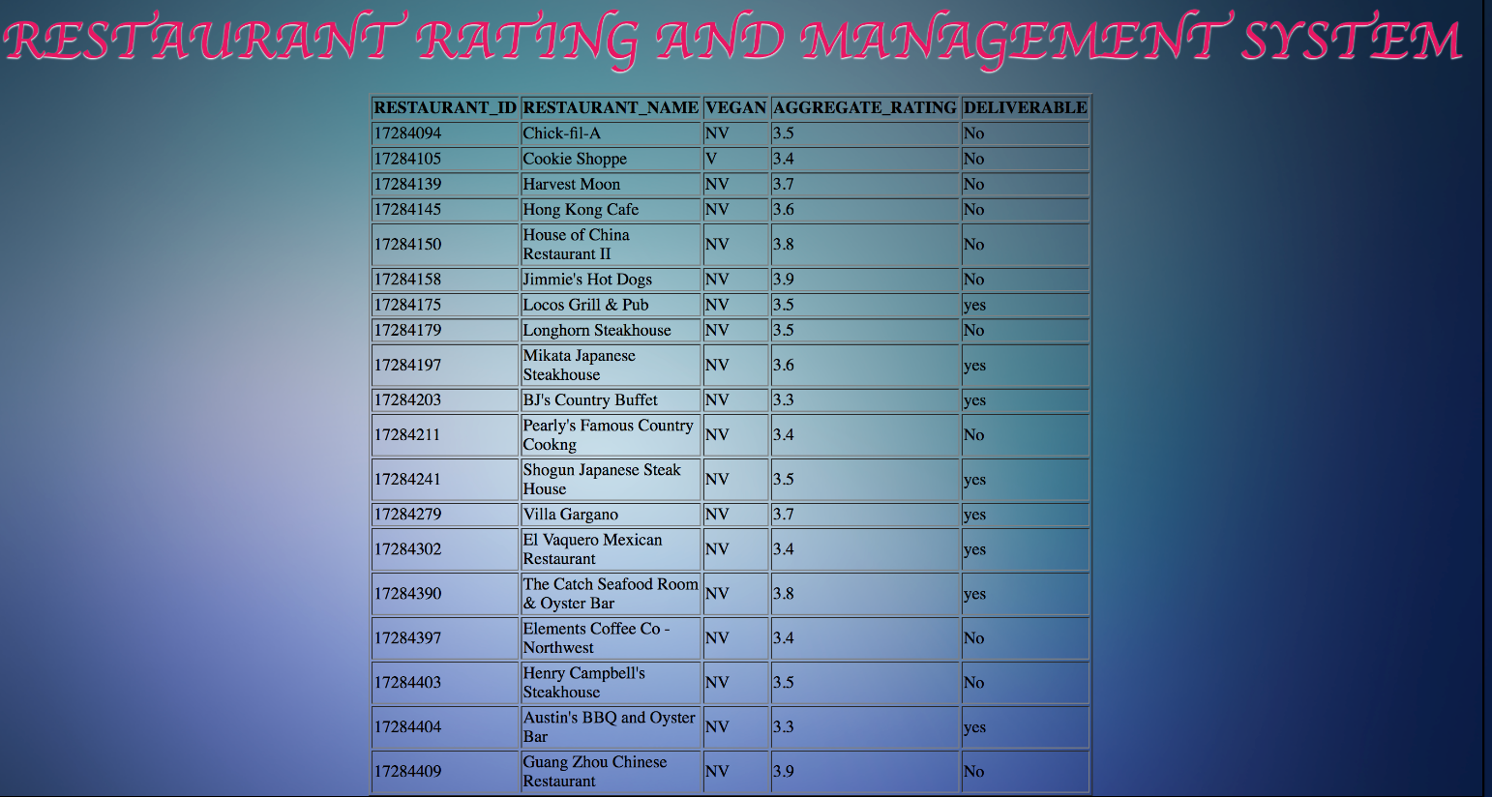

Slide 14



Slide 15
THANK YOU

